Slide 1
Software design pattern
Tarun Mohandas Daryanani
Abián Torres Torres

Slide 2
Content
Introduction
Objetives
Categories
Pattern Templates
Creational Patterns
Examples
Structure Patterns
Examples
Behavoir Patterns
Examples
Documentation
Application in specific areas

Slide 3
Introduction
What are software design patterns?
Objectives of design patterns
Categories
Architecture patterns
Design patterns
Dialects
Pattern templates

Slide 4
Pattern goals
Pattern design allow:
Provide catalogue of reusables elements in the software design pattern.
Avoid repetition for solution search to problems already known and previously solved.
Formalize a common vocabulary between designers.
Standardize the way the design is done.
Facilitate the learning of new generation of designers by condensing existing knowledge.

Slide 5
Pattern categories
Architecture patterns: Provide a solution to organizational scheme in software
Design patterns: Provide a scheme to define the structures in our design or their relations to build software.
Dialects: Low level patterns specific for a programming language of specific environment.

Slide 6
Pattern templates
Pattern name: Standard name for the pattern recognized by the comunity
Patter category: creational, structural or behaviour.
Intention: What problema does it solve?
Motivation: Scenario of the example for the pattern application.
Aplicability: Common uses and criteria to apply the pattern.
Participants: Specify and enumerate the abstract entitiesthat participate.
Structure: Diagrams and clases to explain the pattern.
Colaborations: Explanation of the interrelations between the participants.
Consecuencies: Positive and negatives consecuencies of the pattern application.
Implementation: Appropiate comentaries and tecniques for the pattern implementation.
Example codes: Source code for the pattern implementation.
Known uses.

Slide 7
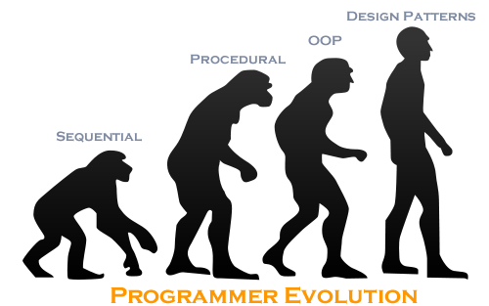
Design patterns
Design patterns can speed up the development process by providing tested, proven development paradigms. Effective software design requires considering issues that may not become visible until later in the implementation.

Slide 8
Design patterns: Types
Creational patterns
Patterns that solve problems with instances creation.
Structural patterns
Patterns that provide a solution to clases or objects composition.
Behaviour patterns
Provide a solution for responsability and interation of classes and objects, as well as algorithms.

Slide 9
Creational patterns
Singleton
Factory Method
Abstract factory
Builder
Prototype

Slide 10
Creational patterns: Singleton
Motivation:
Sometimes it's important to have only one instance for a class. For example, in a system there should be only one window manager
(or only a file system or only a print spooler). Usually singletons are used for centralized management of internal or external resources and they provide a global point of access to themselves.

Slide 11
Creational patterns: Singleton
Applicability:
According to the definition the singleton pattern should be used when there must be exactly one instance of a class, and when it must be accessible to clients from a global access point.
Examples:
Accessing resources in shared mode
Configuration Classes

Slide 12
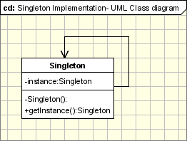
Creational patterns: Singleton
Implementation
The implementation involves a static member in the "Singleton" class, a private constructor and a static public method that returns a reference to the static member.

Slide 13
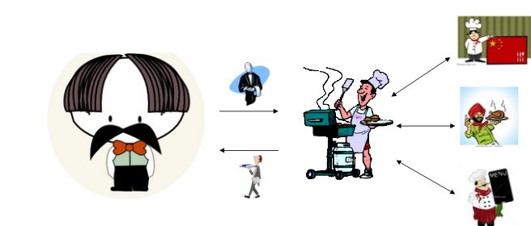
Creational patterns: Abstract Factory
Motivation
Programmers all over the world are trying to avoid the idea of adding code to existing classes in order to make them support encapsulating more general information.
Example for Window.

Slide 14
Creational patterns: Abstract Factory
Applicability
the system is or should be configured to work with multiple families of products.
a family of products is designed to work only all together.
Examples
Phone Number Example
Pizza Factory Example

Slide 15
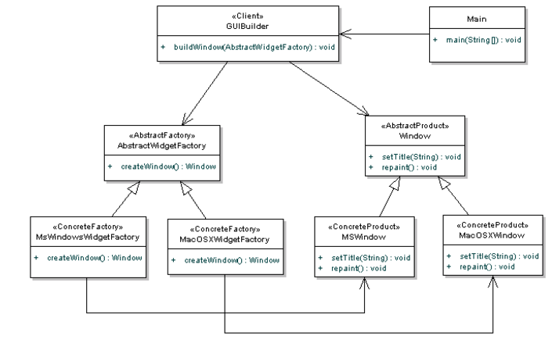
Creational patterns: Abstract Factory
Implementation

Slide 16
Creational patterns: Factory Method
Motivation
It defines an interface for creating an object, but leaves the choice of its type to the subclasses, creation being deferred at run-time. Also known as Virtual Constructor. It works in the same way as libraries.

Slide 17
Creational patterns: Factory Method
Applicability
When a class doesn't know what sub-classes will be required to create
When a class wants that its sub-classes specify the objects to be created.
When the parent classes choose the creation of objects to its sub-classes.
Factories, specifically factory methods, are common in toolkits and frameworks, where library code needs to create objects of types that may be subclassed by applications using the framework.

Slide 18
Creational patterns: Factory Method
Implementation

Slide 19
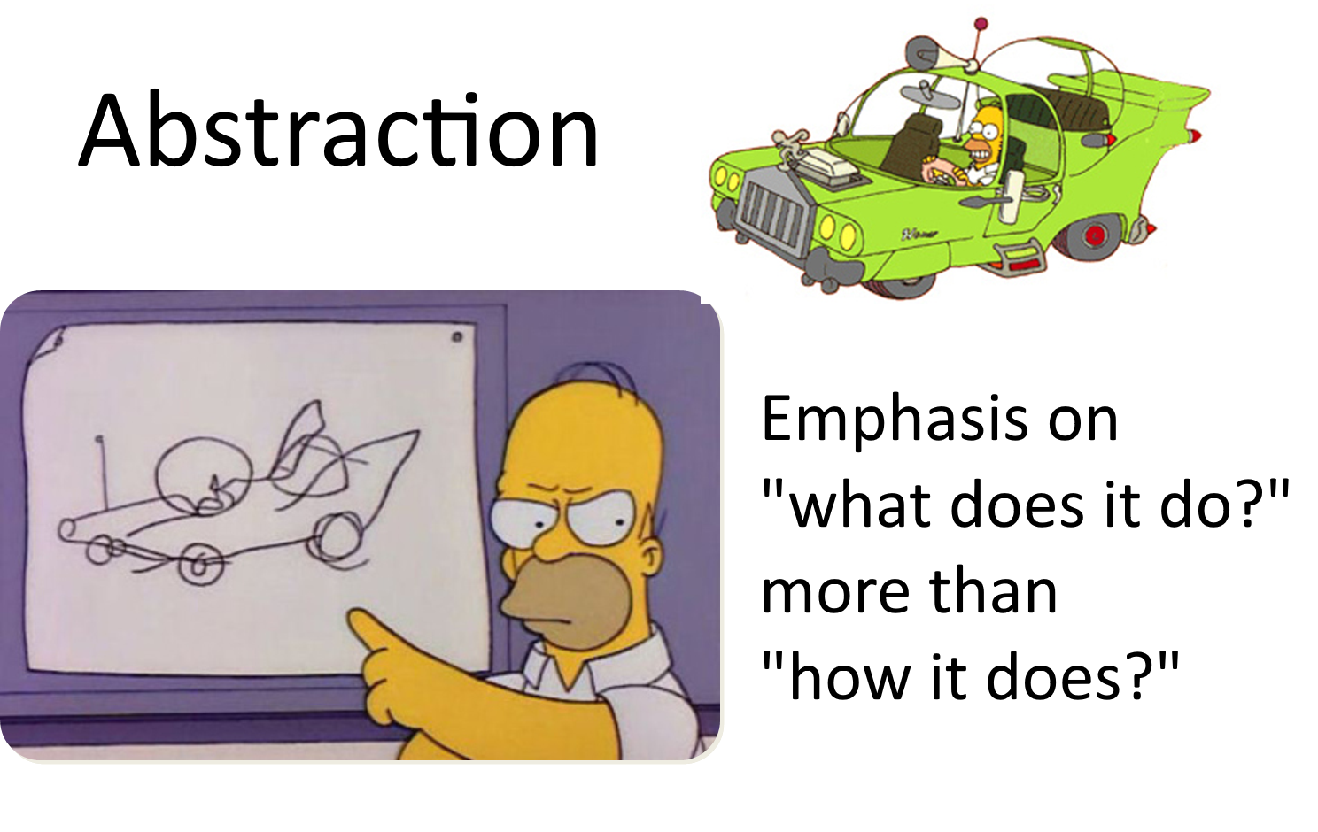
Creational patterns: Builder
Differences between Factory Method and Builder
Builder pattern makes the object step by step and finally returns the result object.
Factory Method directly makes
all the operations and
automatically returns the
final object.

Slide 20
Creational patterns: Prototype
Short Description:

Slide 21
Structural patterns
Adapter
Bridge
Composite
Decorator
Flyweight
Memento
Proxy

Slide 22
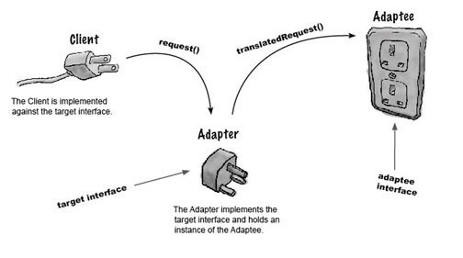
Structural patterns: Adapter
Motivation:
Adapter pattern works as a bridge between two incompatible interfaces. This type of design pattern comes under structural pattern as this pattern combines the capability of two independent interfaces.

Slide 23
Structural patterns: Adapter
Applicability:
Use the Adapter pattern when you want to use an existing class, and its interface does not match the one you need.
You want to create a reusable class that cooperates with unrelated or unforeseen classes, that is, classes that don’t necessarily have compatible interfaces.

Slide 24
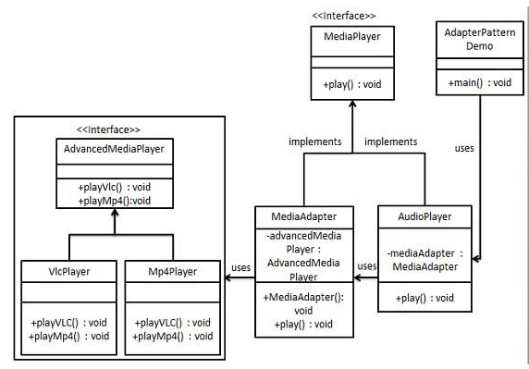
Structural patterns: Adapter
Implementation:

Slide 25
Structural patterns: Bridge
Motivation:
This pattern involves an interface which acts as a bridge which makes the functionality of concrete classes independent from interface implementer classes. Both types of classes can be altered structurally without affecting each other.

Slide 26
Structural patterns: Bridge
Applicability:
Used when we have independent classes but need to cooperate. So these classes can change, but they will always be able to communicate and depend on each other.

Slide 27
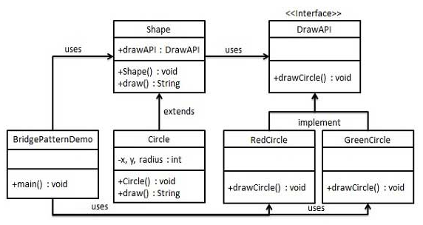
Structural patterns: Bridge
Implementation

Slide 28
Structural patterns: Decorator
Motivation
Decorator pattern allows a user to add new functionality to an existing object without altering its structure. This type of design pattern comes under structural pattern as this pattern acts as a wrapper to existing class.

Slide 29
Structural patterns: Decorator
Applicability:
Used when we have independent classes but need to cooperate. So these classes can change, but they will always be able to communicate and depend on each other.

Slide 30
Structural patterns: Decorator
Implementation

Slide 31
Structural patterns: Composite
Short Description:

Slide 32
Structural patterns: Flyweight
Short Description:

Slide 33
Structural patterns: Memento
Short Description:

Slide 34
Structural patterns: Proxy
Short Description:

Slide 35
https://sourcemaking.com/design_patterns
https://www.genbetadev.com/metodologias-de-programacion/patrones-de-diseno-que-son-y-por-que-debes-usarlos
https://msdn.microsoft.com/es-es/library/bb972240.aspx
https://www.fdi.ucm.es/profesor/jpavon/poo/2.14PDOO.pdf
http://c2.com/doc/oopsla87.html
http://www.buyya.com/254/Patterns/
https://en.wikipedia.org/wiki/Software_design_pattern
http://www.oodesign.com/
https://dzone.com/articles/design-patterns-abstract-factory
https://sourcemaking.com/design_patterns/builder/java/2
https://www.tutorialspoint.com/design_pattern/adapter_pattern.htm

